Slide 1





SIM RACING DYNAMICS
A COMPARISON OF FORMULA 1 ‘25 GRAND PRIX QUALIFYING BETWEEN CHARLES LECLERC AND LEWIS HAMILTON

Slide 2

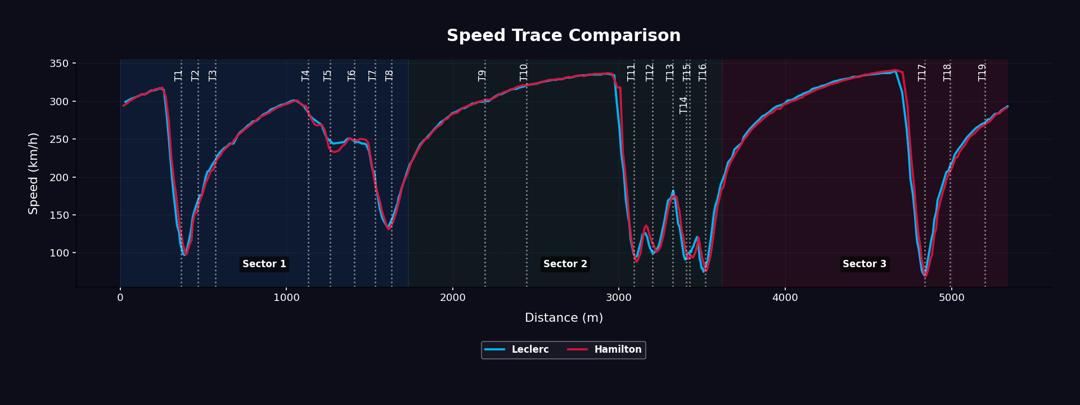
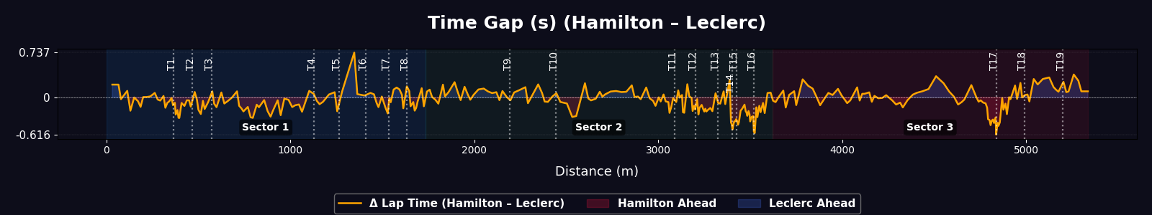
FORMULA 1 MIAMI GRAND PRIX 2025
LECLERC: 1.26.743
HAMILTON: 1.26.847

Slide 3
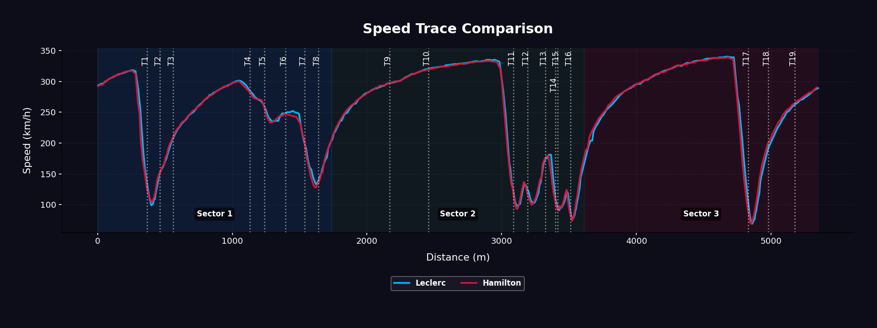
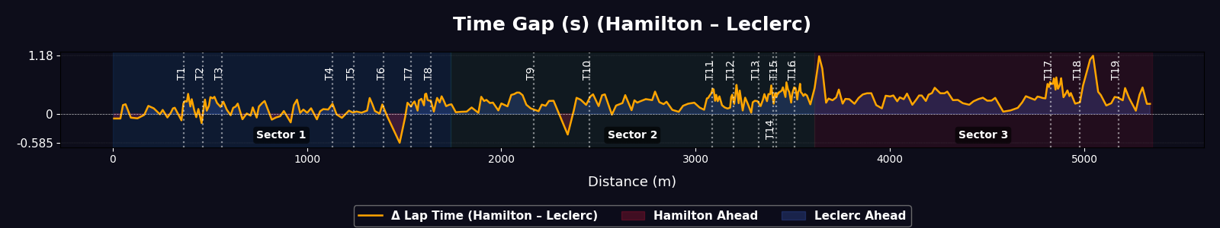
FORMULA 1 MIAMI SPRINT 2025
LECLERC: 1.26.729
HAMILTON: 1.26.894

Slide 4
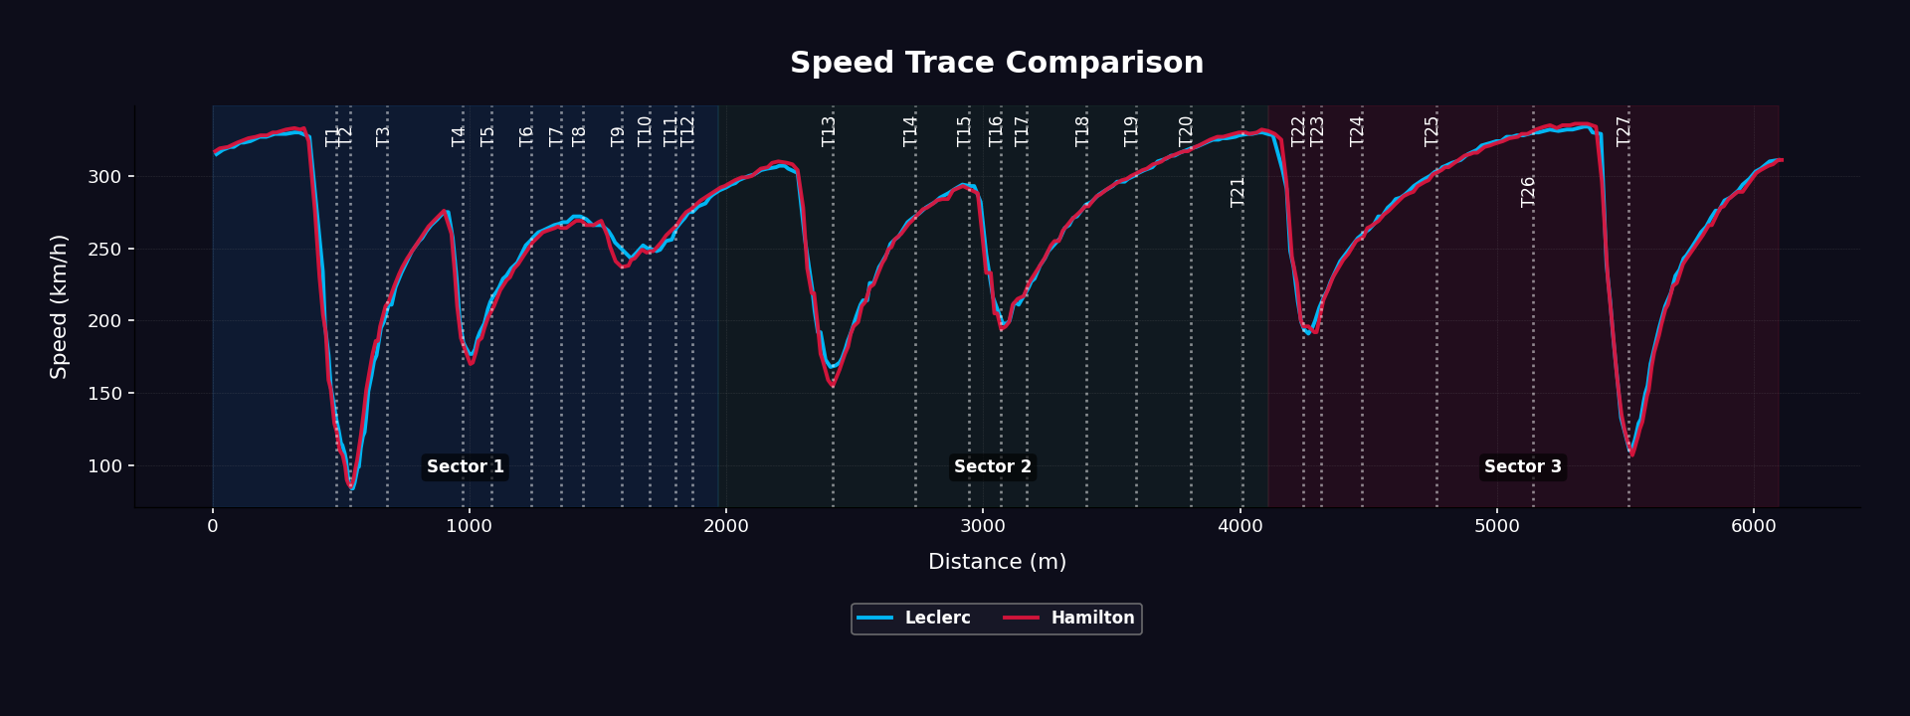
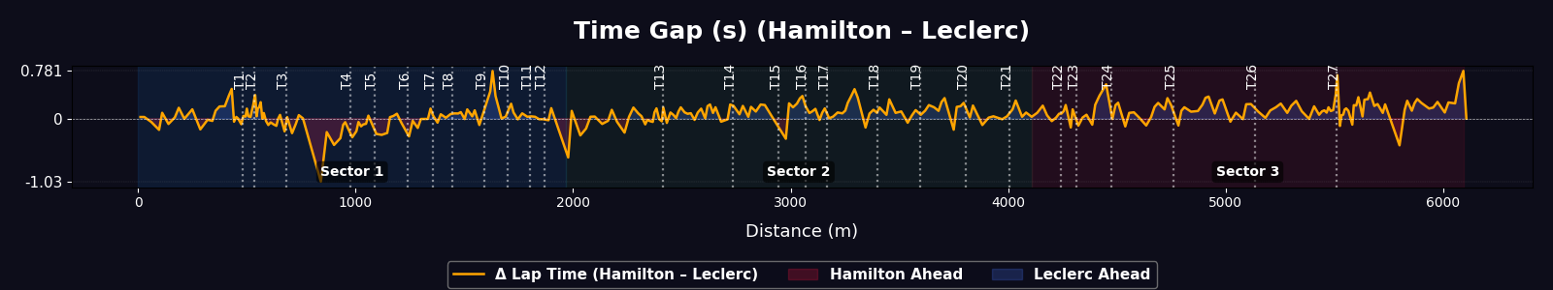
FORMULA 1 SAUDI ARABIAN GRAND PRIX 2025
LECLERC: 1.27.498
HAMILTON: 1.27.879

Slide 5
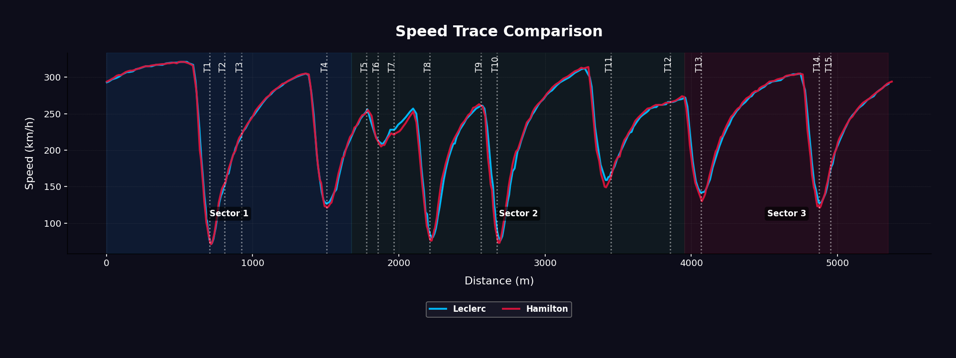
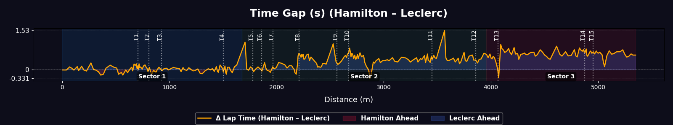
FORMULA 1 BAHRAIN GRAND PRIX 2025
LECLERC: 1.29.838
HAMILTON: 1.30.768

Slide 6
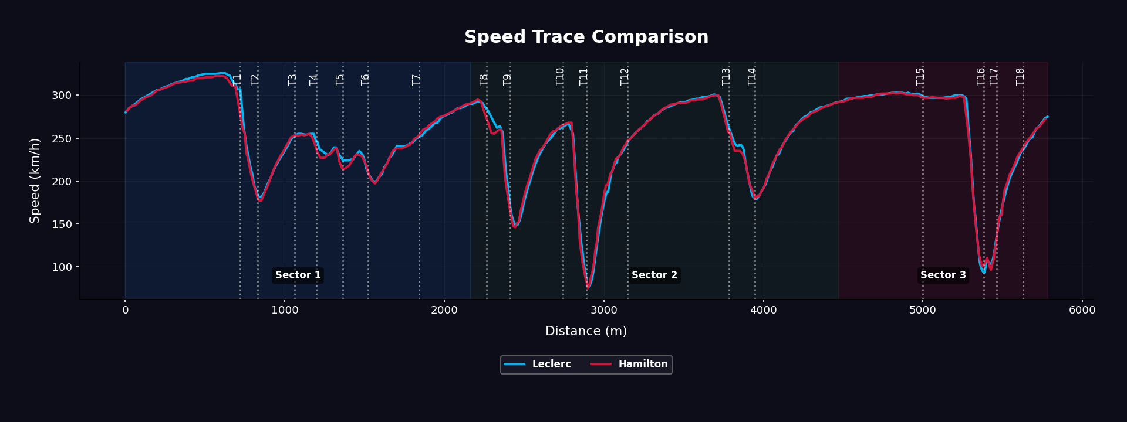
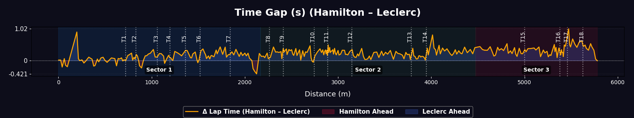
FORMULA 1 JAPANESE GRAND PRIX 2025
LECLERC: 1.27.232
HAMILTON: 1.27.445

Slide 7
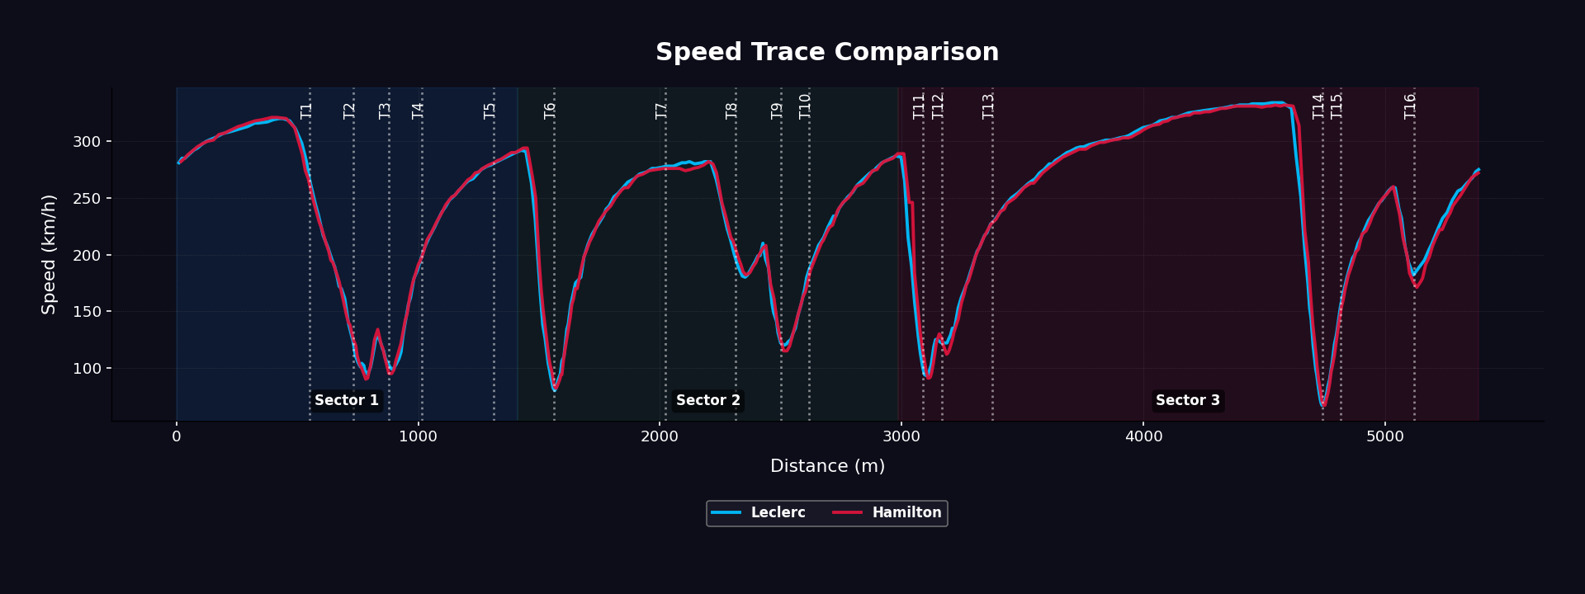
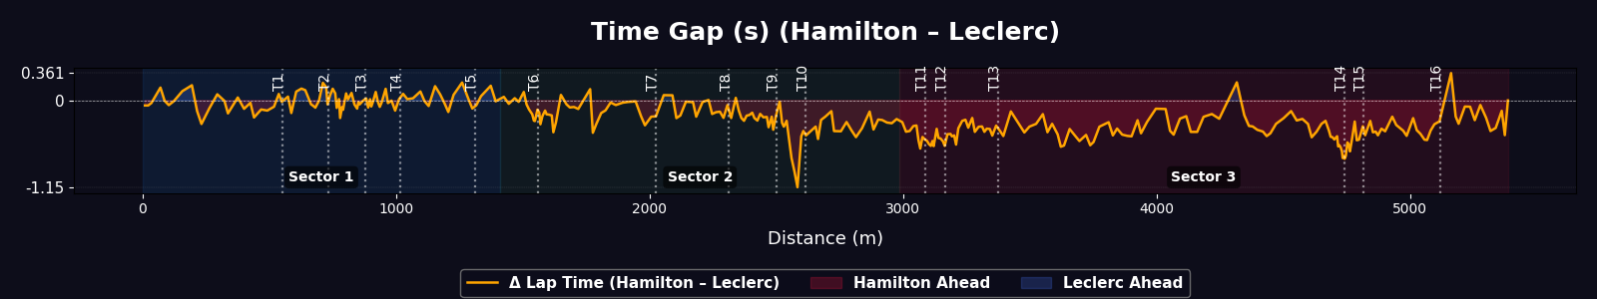
FORMULA 1 CHINESE GRAND PRIX 2025
LECLERC: 1.30.855
HAMILTON: 1.30.637

Slide 8
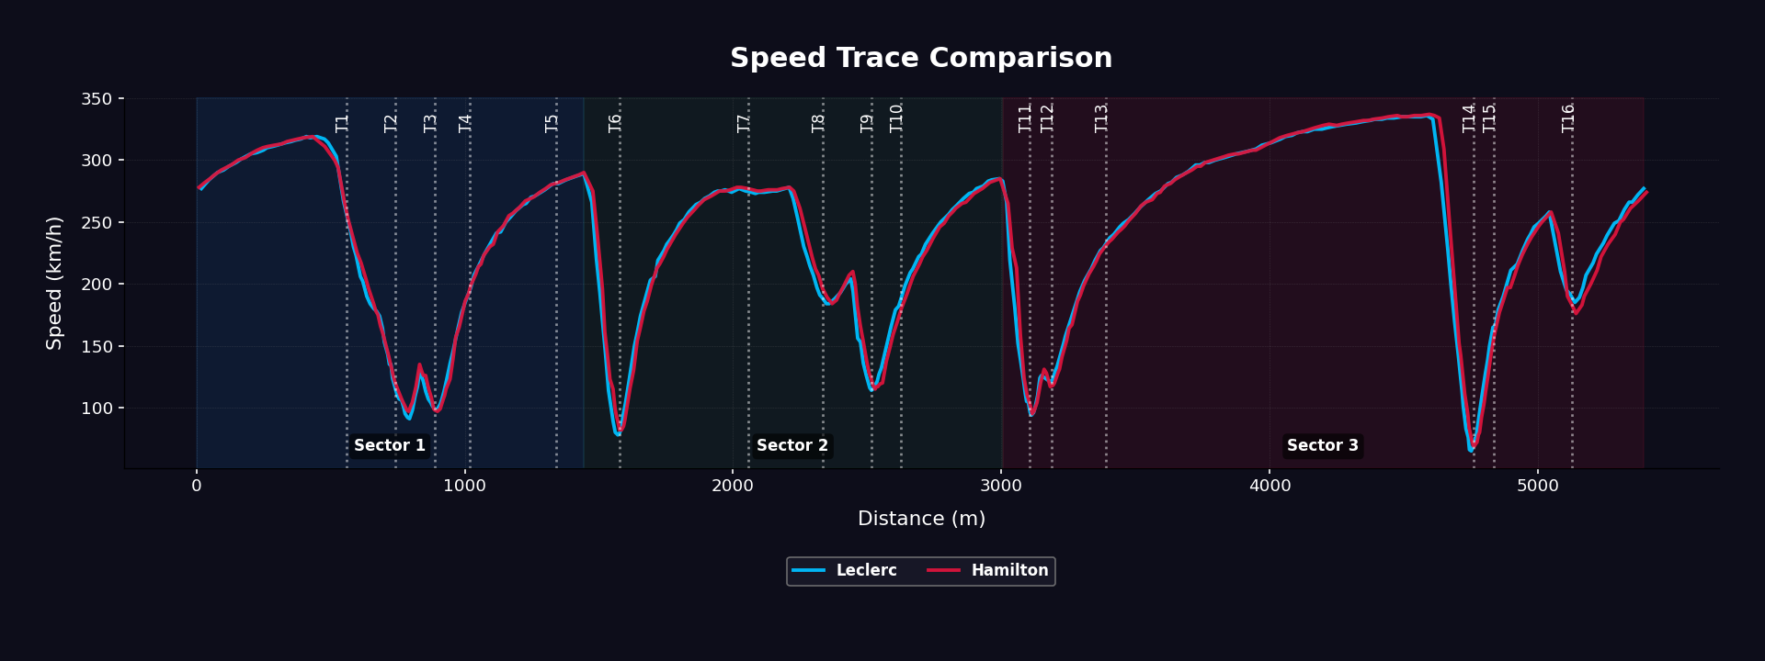
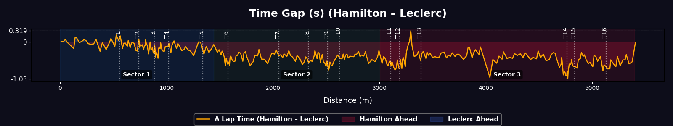
FORMULA 1 CHINESE SPRINT 2025
LECLERC: 1.31.001
HAMILTON: 1.30.691

Slide 9
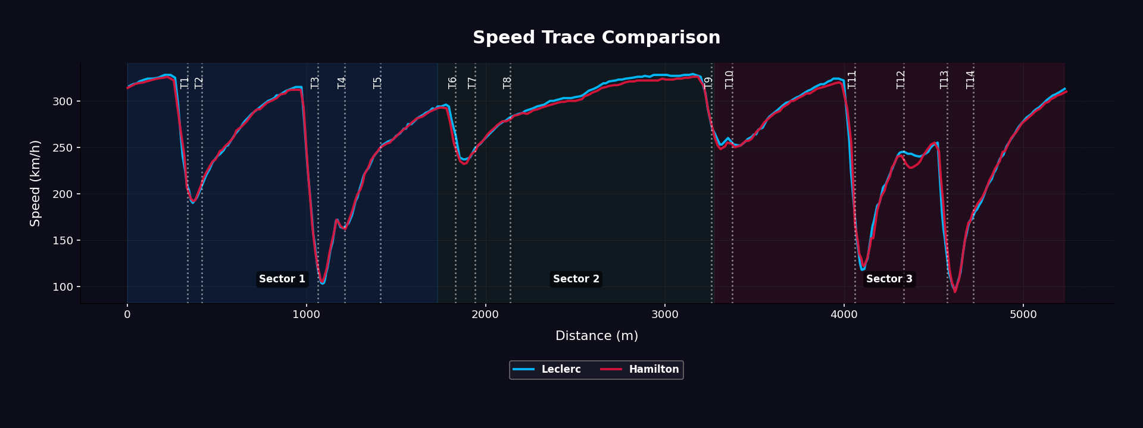
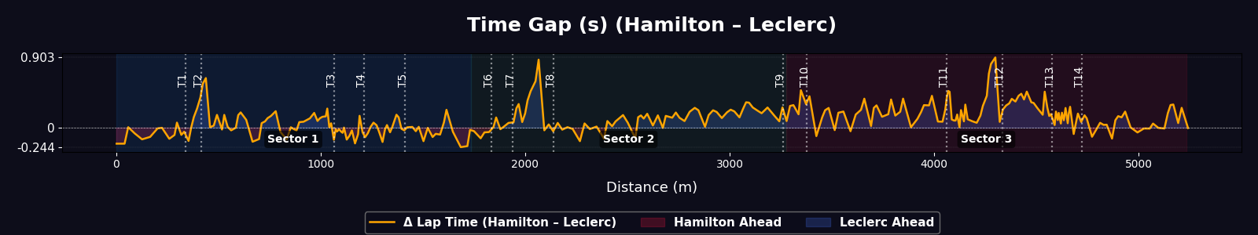
FORMULA 1 AUSTRALIAN GRAND PRIX 2025
LECLERC: 1.15.694
HAMILTON: 1.15.912

Slide 10


POINTS TO NOTE
A presentation is a formal talk, often delivered in front of an audience, aimed at conveying information, persuading others, or sharing insights on a particular topic. Presentations can take various forms, such as verbal speeches, slideshows, demonstrations, or multimedia displays. They are commonly used in academic, professional, and social settings to communicate ideas, proposals, reports, or findings. Effective presentations typically involve careful planning, organization, and delivery techniques to engage the audience and effectively convey the intended message.
A presentation is a formal talk, often delivered in front of an audience, aimed at conveying information, persuading others, or sharing insights on a particular topic. Presentations can take various forms, such as verbal speeches, slideshows, demonstrations, or multimedia displays. They are commonly used in academic, professional, and social settings to communicate ideas, proposals, reports, or findings. Effective presentations typically involve careful planning, organization, and delivery techniques to engage the audience and effectively convey the intended message.

Slide 11
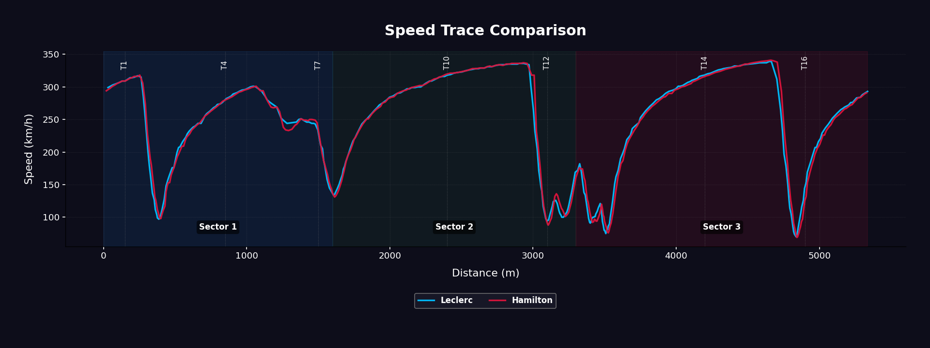
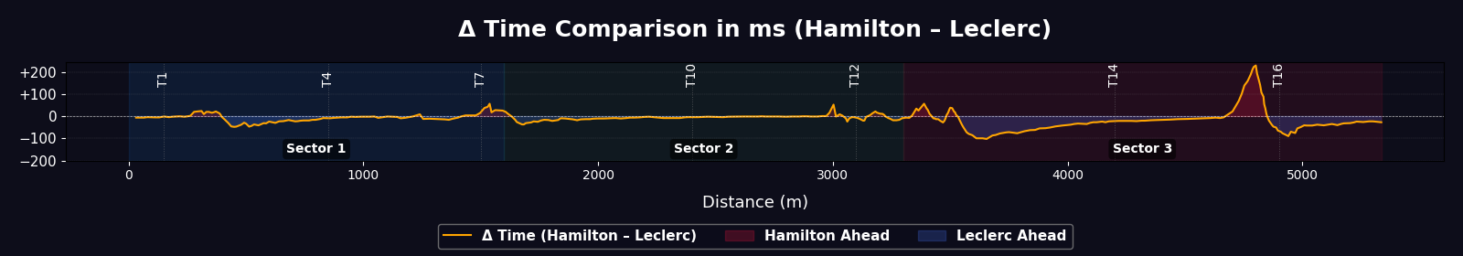
FORMULA 1 MIAMI GRAND PRIX 2025

Slide 12
SIM RACING DYNAMICS
THANK
YOU

Slide 13


SALFORD & CO.
THANK
YOU

Slide 14



MISSION & VISION
HOME
SERVICE
ABOUT US
CONTACT US
COMPANY
OUR MISSION
A presentation is a formal talk, often delivered in front of an audience, aimed at conveying information, persuading others, or sharing insights on a particular topic. Presentations can take various forms, such as verbal speeches, slideshows, demonstrations, or multimedia displays.
A presentation is a formal talk, often delivered in front of an audience, aimed at conveying information, persuading others, or sharing insights on a particular topic. Presentations can take various forms, such as verbal speeches, slideshows, demonstrations, or multimedia displays.
OUR VISION
A presentation is a formal talk, often delivered in front of an audience, aimed at conveying information, persuading others, or sharing insights on a particular topic. Presentations can take various forms, such as verbal speeches, slideshows, demonstrations, or multimedia displays.
A presentation is a formal talk, often delivered in front of an audience, aimed at conveying information, persuading others, or sharing insights on a particular topic. Presentations can take various forms, such as verbal speeches, slideshows, demonstrations, or multimedia displays.

Slide 15



PROVIDE VARIOUS TYPES
HOME
SERVICE
ABOUT US
CONTACT US
OF NEW AND USED CAR
WRITE YOUR DESCRIPTION
01
A presentation is a formal talk, often delivered in front of an audience, aimed at conveying information, persuading others, or sharing insights on a particular topic. Presentations can take various forms, such as verbal speeches, slideshows, demonstrations, or multimedia displays.
WRITE YOUR DESCRIPTION
02
A presentation is a formal talk, often delivered in front of an audience, aimed at conveying information, persuading others, or sharing insights on a particular topic. Presentations can take various forms, such as verbal speeches, slideshows, demonstrations, or multimedia displays.

Slide 16





OUR
SERVICE
HOME
SERVICE
ABOUT US
CONTACT US
SERVICE 01
A presentation is a formal talk, often delivered in front of an audience, aimed at conveying information, persuading others, or sharing insights on a particular topic.
WRITE YOUR DESCRIPTION
A presentation is a formal talk, often delivered in front of an audience, aimed at conveying information, persuading others, or sharing insights on a particular topic. Presentations can take various forms, such as verbal speeches, slideshows, demonstrations, or multimedia displays. They are commonly used in academic, professional, and social settings to communicate ideas, proposals, reports, or findings. Effective presentations typically involve careful planning, organization, and delivery techniques to engage the audience and effectively convey the intended message.
SERVICE 02
A presentation is a formal talk, often delivered in front of an audience, aimed at conveying information, persuading others, or sharing insights on a particular topic.
SERVICE 03
A presentation is a formal talk, often delivered in front of an audience, aimed at conveying information, persuading others, or sharing insights on a particular topic.
SERVICE 04
A presentation is a formal talk, often delivered in front of an audience, aimed at conveying information, persuading others, or sharing insights on a particular topic.

Slide 17




OUR
PORTFOLIO
HOME
SERVICE
ABOUT US
CONTACT US
A presentation is a formal talk, often delivered in front of an audience, aimed at conveying information, persuading others, or sharing insights on a particular topic.
A presentation is a formal talk, often delivered in front of an audience, aimed at conveying information, persuading others, or sharing insights on a particular topic.
01
WRITE YOUR DESCRIPTION
03
WRITE YOUR DESCRIPTION
02
WRITE YOUR DESCRIPTION
04
WRITE YOUR DESCRIPTION
A presentation is a formal talk, often delivered in front of an audience, aimed at conveying information, persuading others, or sharing insights on a particular topic.
A presentation is a formal talk, often delivered in front of an audience, aimed at conveying information, persuading others, or sharing insights on a particular topic.

Slide 18



OUR CLIENT
HOME
SERVICE
ABOUT US
CONTACT US
TESTIMONY
HARUMI KOBAYASHI
A presentation is a formal talk, often delivered in front of an audience, aimed at conveying information, persuading others, or sharing insights on a particular topic. Presentations can take various forms, such as verbal speeches, slideshows, demonstrations, or multimedia displays.
A presentation is a formal talk, often delivered in front of an audience, aimed at conveying information, persuading others, or sharing insights on a particular topic. Presentations can take various forms, such as verbal speeches, slideshows, demonstrations, or multimedia displays. They are commonly used in academic, professional, and social settings to communicate ideas, proposals, reports, or findings. Effective presentations typically involve careful planning, organization, and delivery techniques to engage the audience and effectively convey the intended message.
MORGAN MAXWELL
A presentation is a formal talk, often delivered in front of an audience, aimed at conveying information, persuading others, or sharing insights on a particular topic. Presentations can take various forms, such as verbal speeches, slideshows, demonstrations, or multimedia displays.

Slide 19




HOME
SERVICE
ABOUT US
CONTACT US
OUR PROFESSIONAL
TEAM
NEIL TRAN
CHIDI EZE
CHIAKI SATO
KETUT SUSILO

Slide 20





HOME
SERVICE
ABOUT US
CONTACT US
CONTACT
US
+123-456-7890
WWW.REALLYGREATSITE.COM
HELLO@REALLYGREATSITE.COM
123 ANYWHERE ST., ANY CITY, ST 12345

